Slide 1
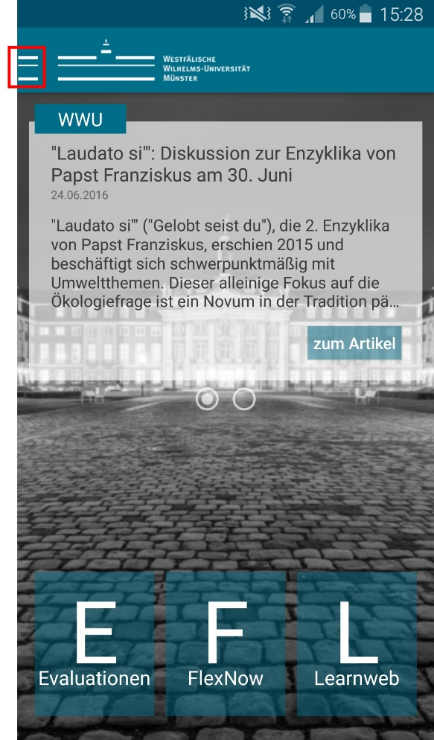
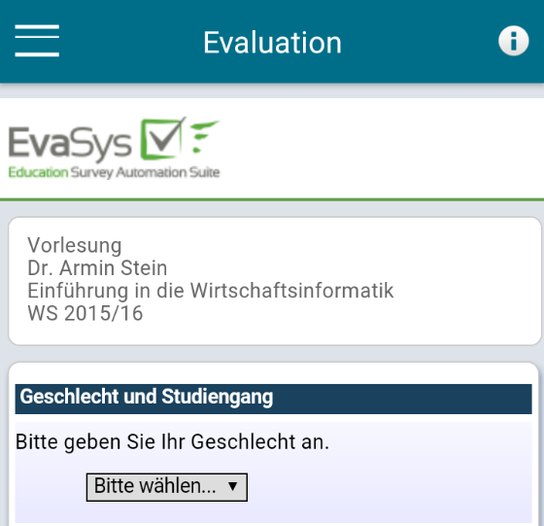
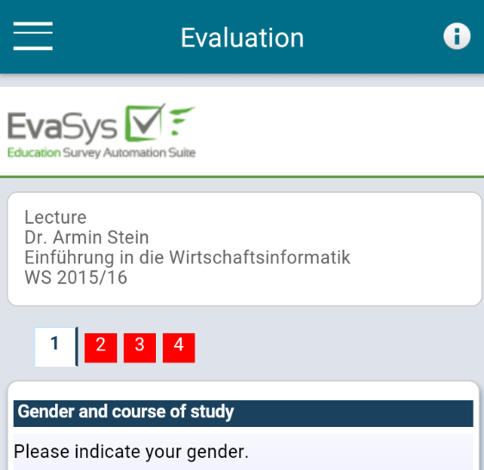
Instructions
Evaluating with the Faculty App
Select the menu point „Evaluations“ from the side bar.
Open the corresponding evaluation in the following menu.
Please pay attention to the type of evaluation shown in the header.
The necessary codes for subject of study and program can be found in the information menu (marked with an „i“).
No compatible device or not willing to use the app? Please follow the link in your inbox.
Everything in this process is anonymized!

